Slide 1
Life Management Mobile App 2.0
Team Members:
Product owner:
Instructor:
Lazaro Fernandez, Natalia Filippova, Eric Rado
Ranjeet Deshmukh
Masoud Sadjadi

Slide 2
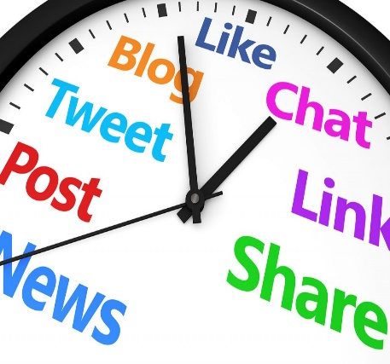


PROBLEM
Many people feel lack of purpose, fulfillment and contentment
People spend time on things that do not really matter
There is a need to help people find happiness and meaning in life
Distractions from things that make you happy
Feel unsatisfied and empty deep inside
Need to find happiness and meaning in life

Slide 3



SOLUTION
Help people progressively discover and build a better version of themselves through:
Find JOY in what you do
Do things you are PASSIONATE about
Find a way to GIVE BACK to others

Slide 4
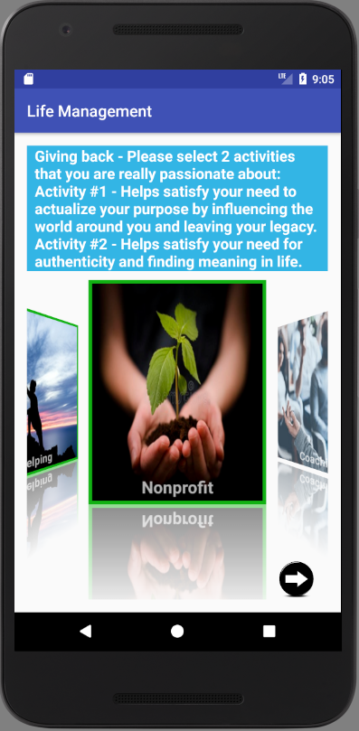
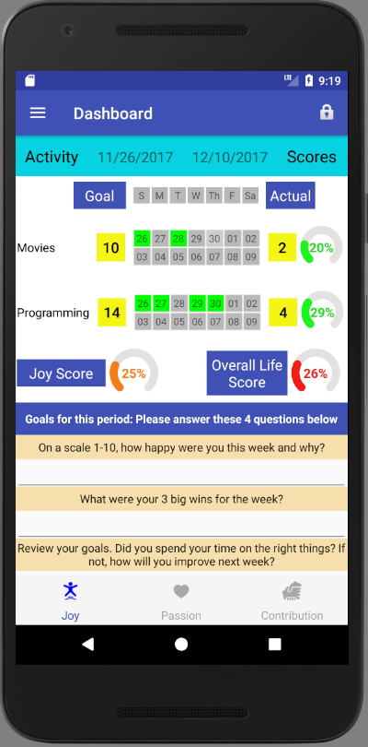
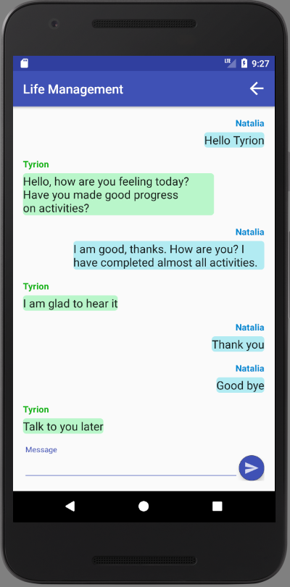
Life Management Mobile App
Helps people to stay focused on activities that help find a sense of joy, passion and contribution
Activities Selection
Dashboard
Coach Support

Slide 5
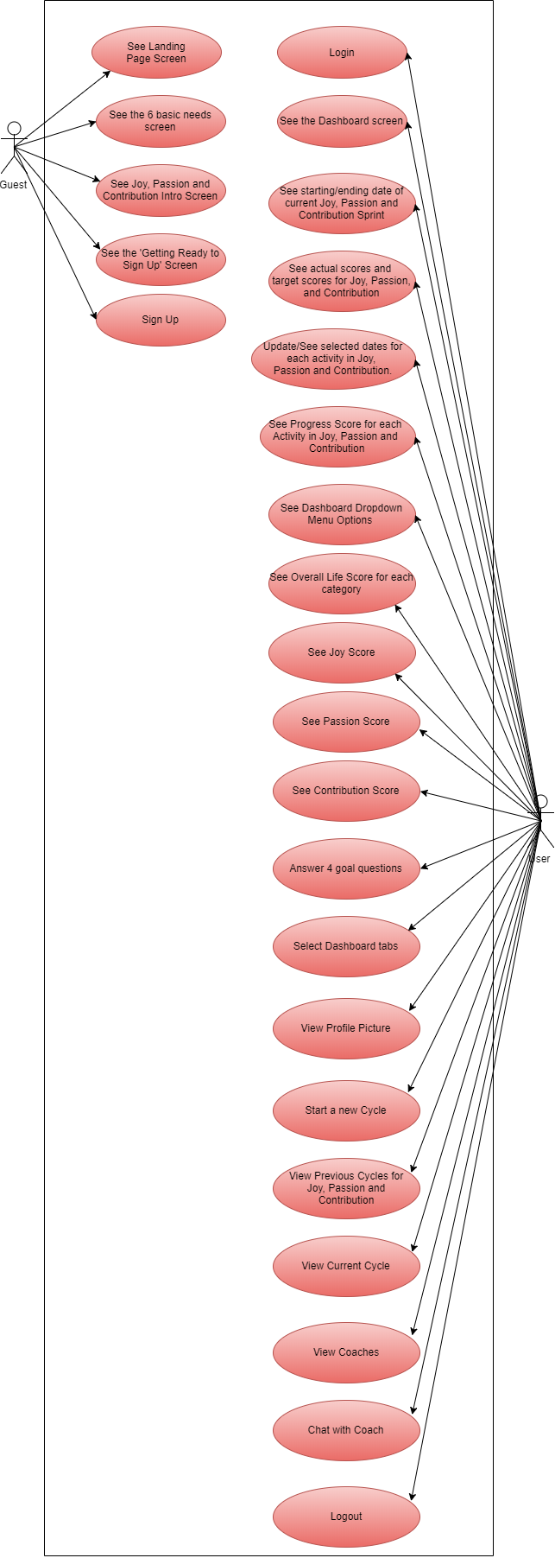
Requirements: Use Case Diagram

Slide 6
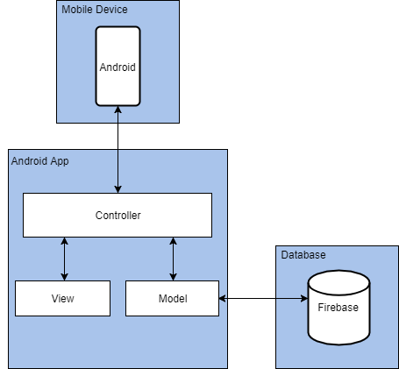
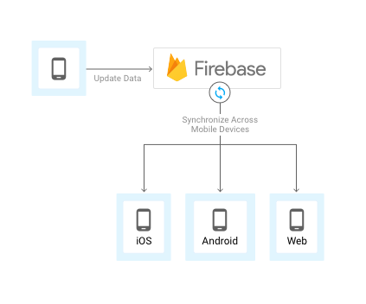
System Design
The system was developed using Model-View-Controller (MVC) architectural pattern:

Slide 7
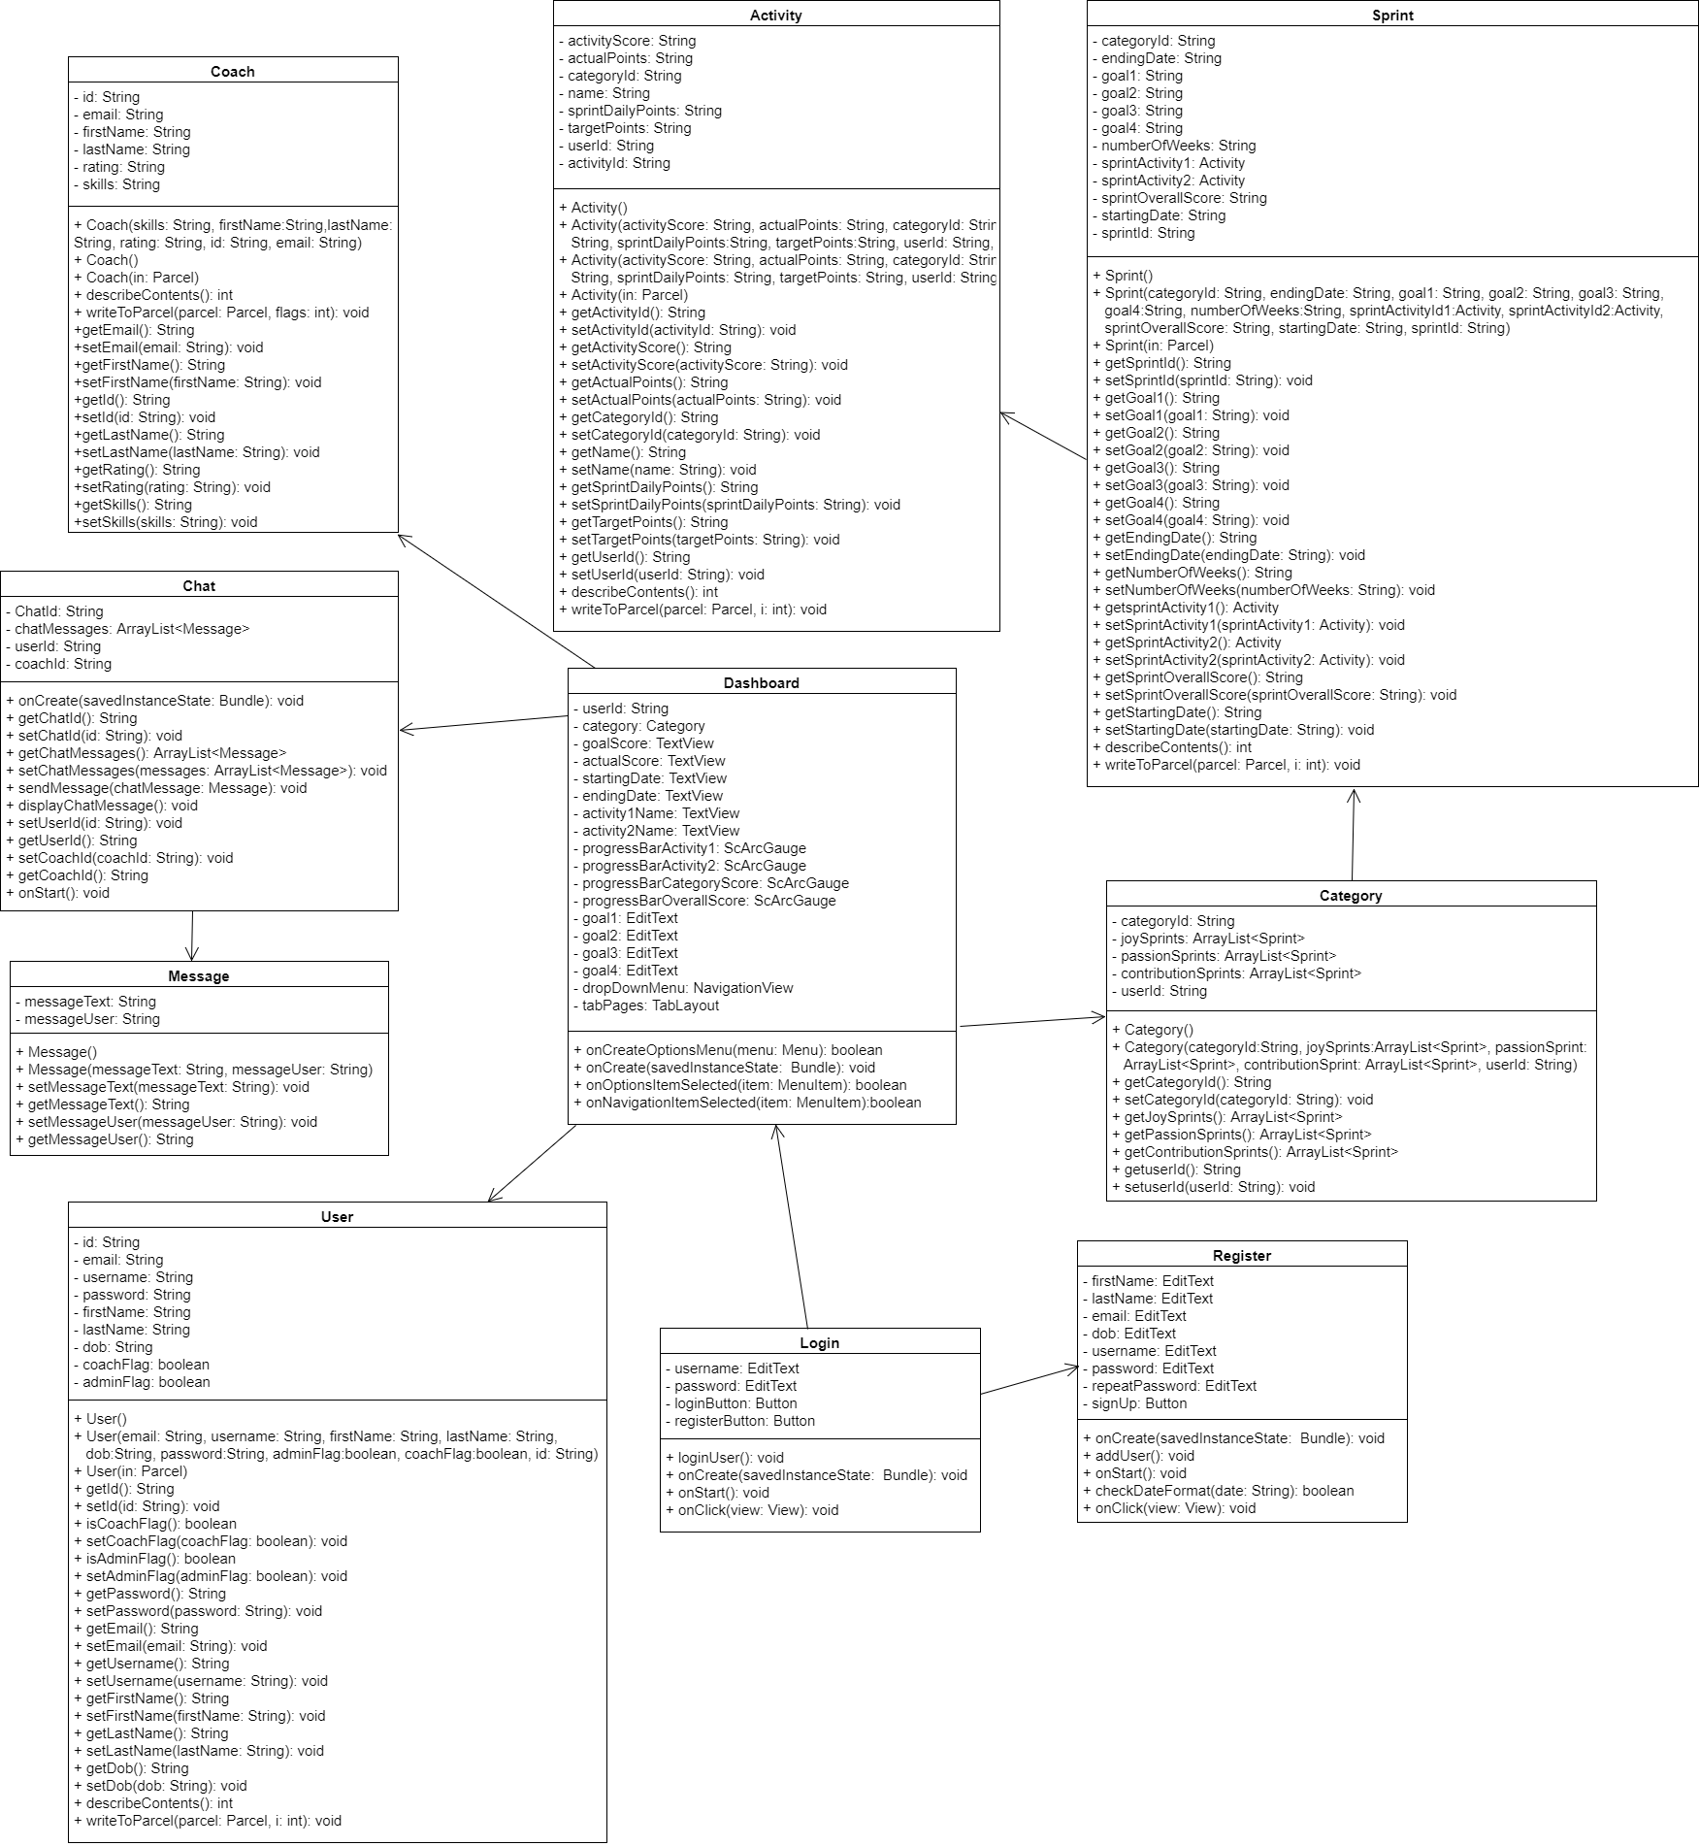
Class Diagram

Slide 8
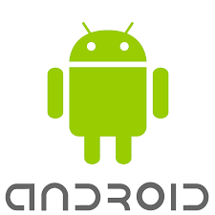

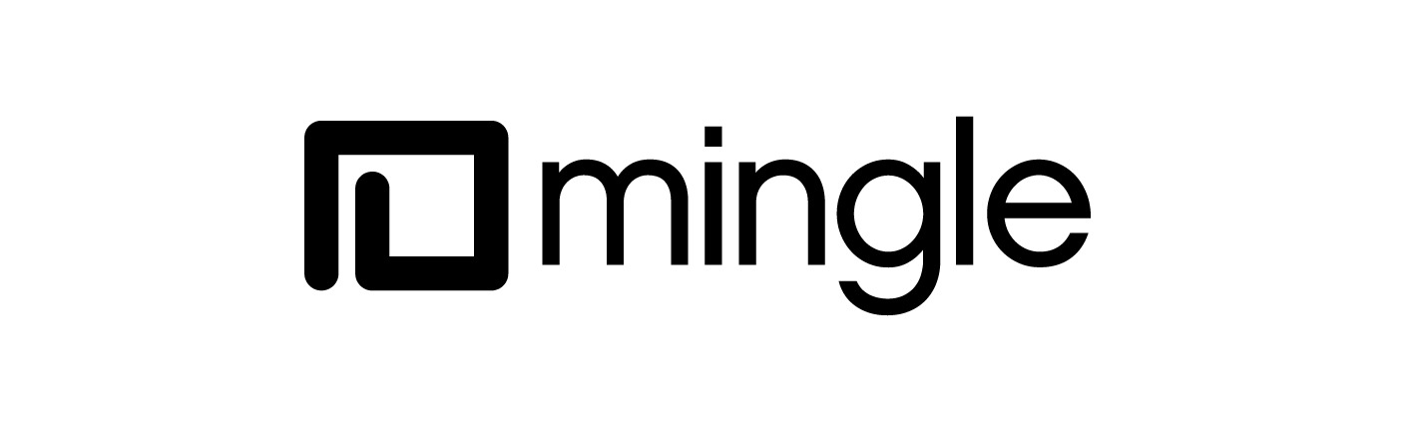




Implementation
Application was developed using Android Studio 2.3.3 IDE
Java as programming language
Android SDK tools
XML for defining User Interface
Firebase Realtime Database for data storage and synchronization
Agile project management using Mingle
Git for source control

Slide 9
User Stories
View joy, passion, contribution introduction page
View user’s dashboard
Visualize user’s progress
Start new cycle from user’s dashboard
Select activities that bring sense of contribution
Set up new sprint and save settings
Select and communicate with coaches
Safely sign out of the application

Slide 10
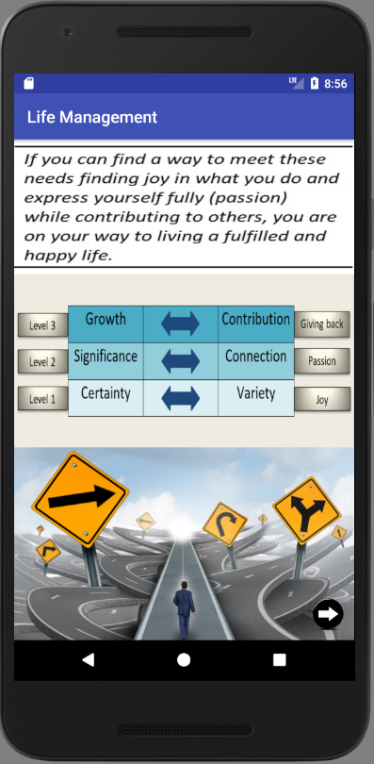
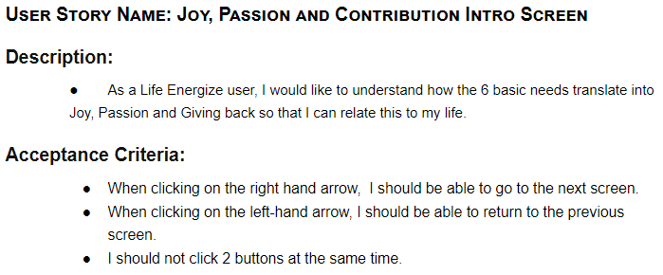
User Story 1 Description

Slide 11
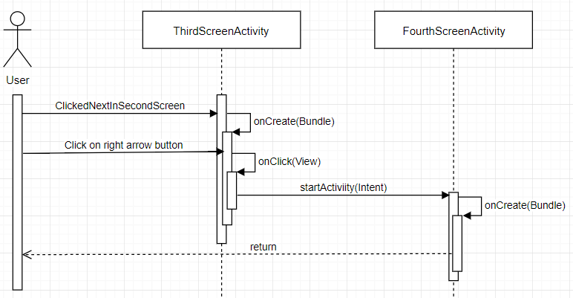
User Story 1 Implementation

Slide 12
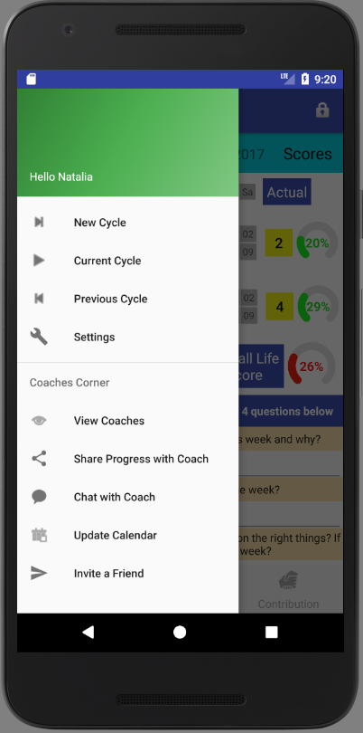
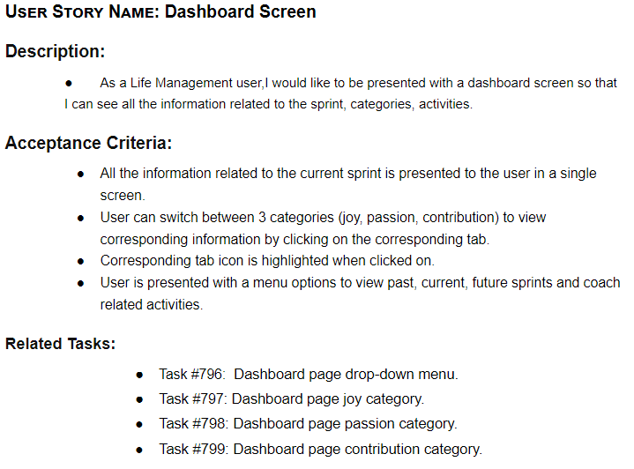
User Story 2 Description

Slide 13
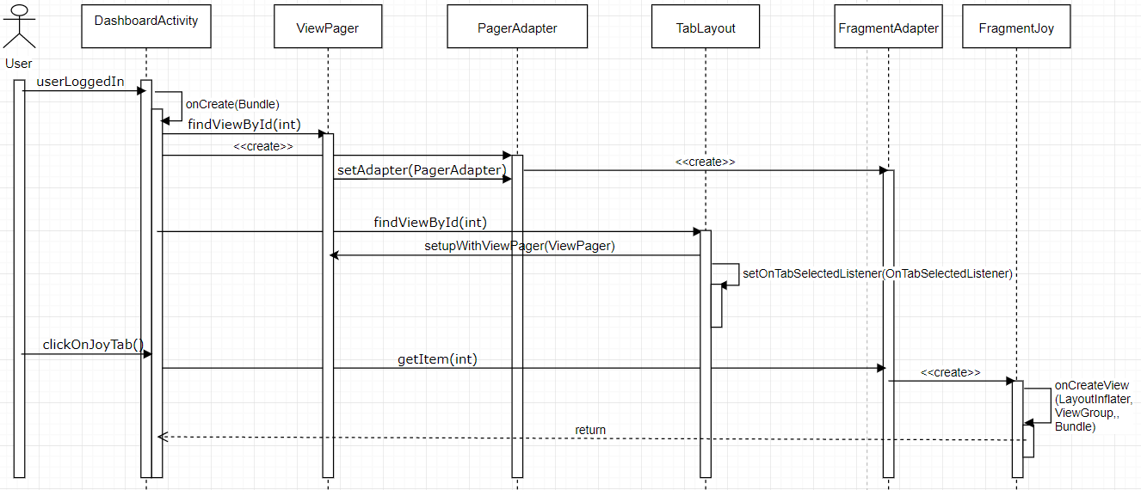
User Story 2 Implementation

Slide 14
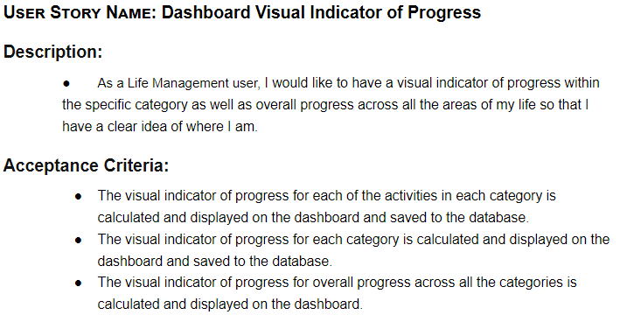
User Story 3 Description

Slide 15
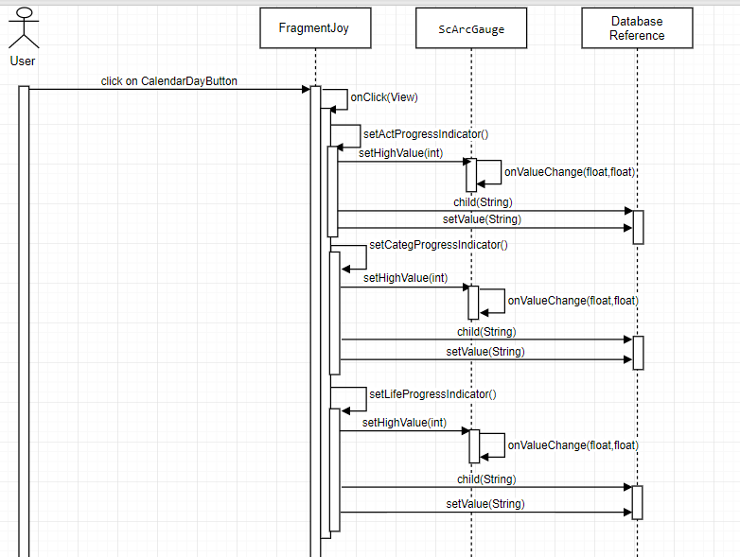
User Story 3 Implementation

Slide 16
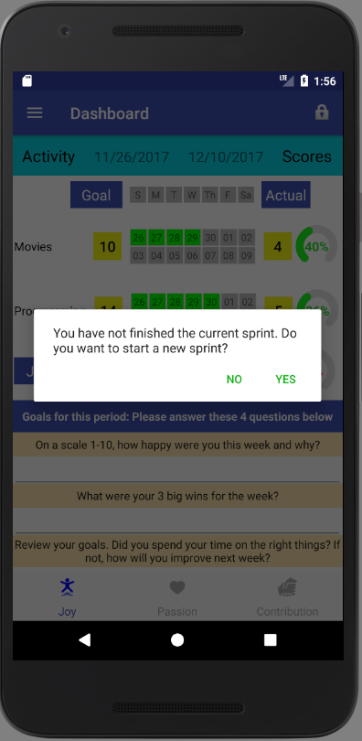
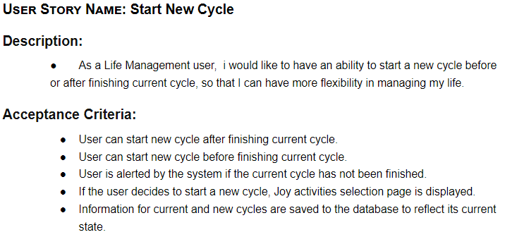
User Story 4 Description

Slide 17
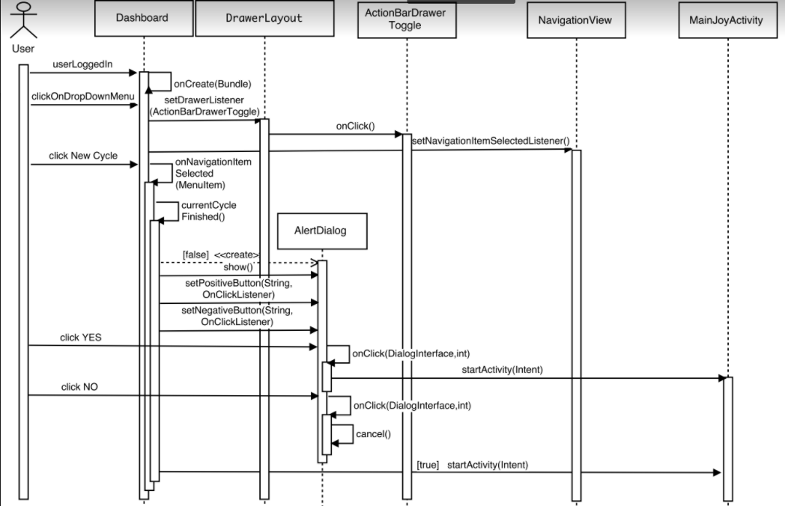
User Story 4 Implementation

Slide 18
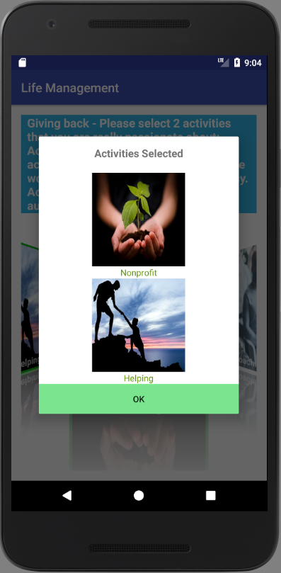
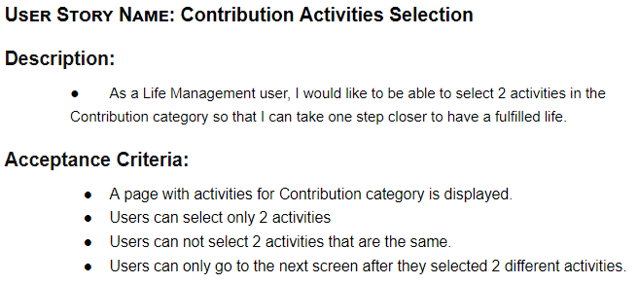
User Story 5 Description

Slide 19
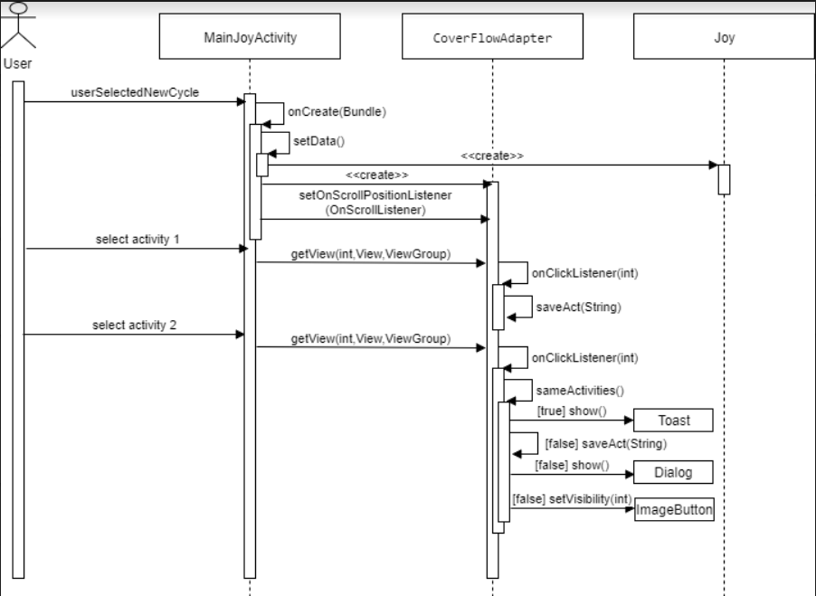
User Story 5 Implementation
MainGiveBackActivity
CoverFlowAdapter
GiveBack

Slide 20
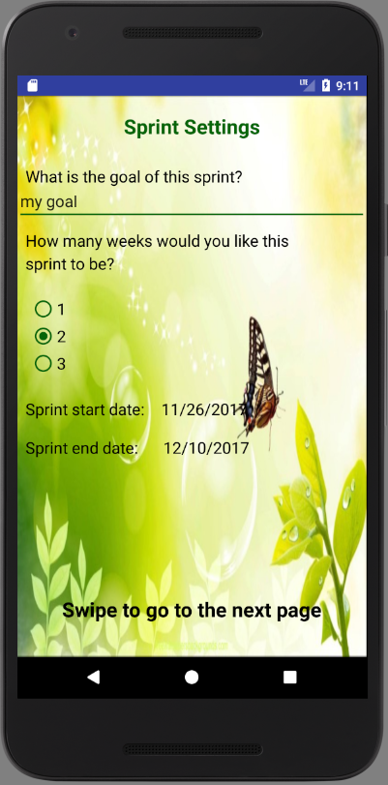
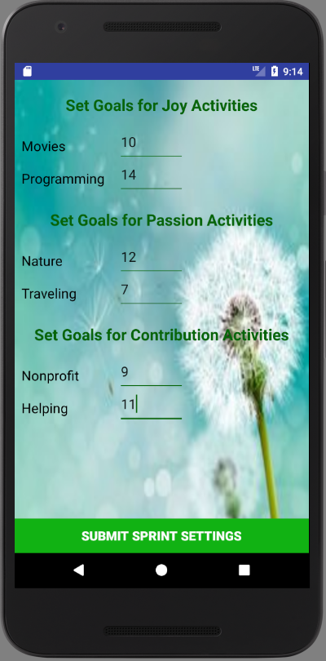
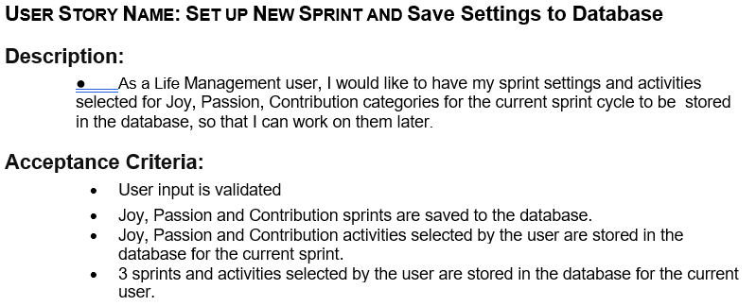
User Story 6 Description

Slide 21
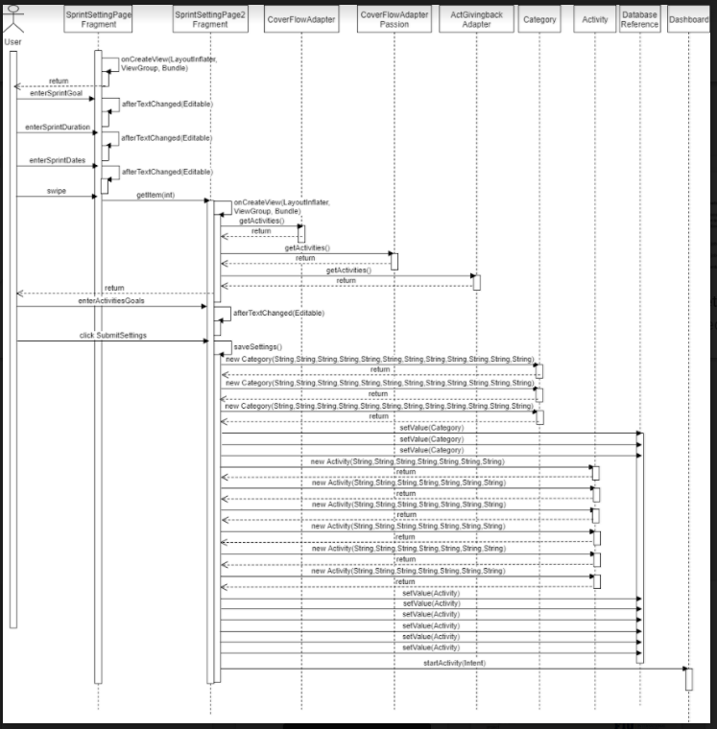
User Story 6 Implementation

Slide 22
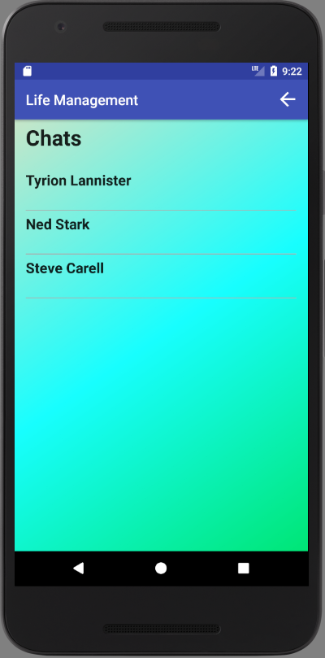
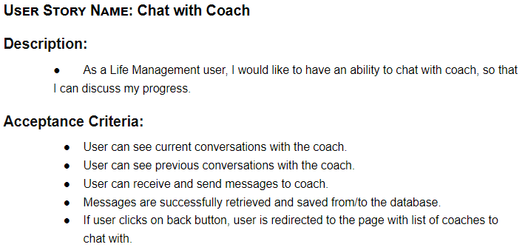
User Story 7 Description

Slide 23
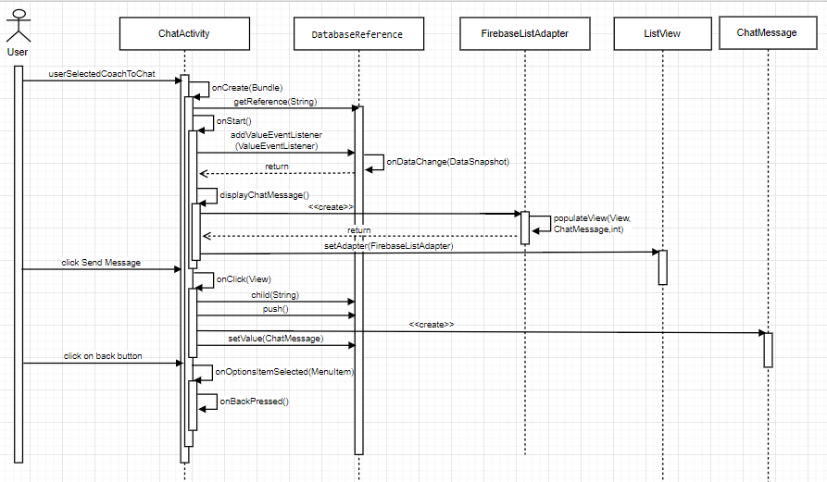
User Story 7 Implementation

Slide 24
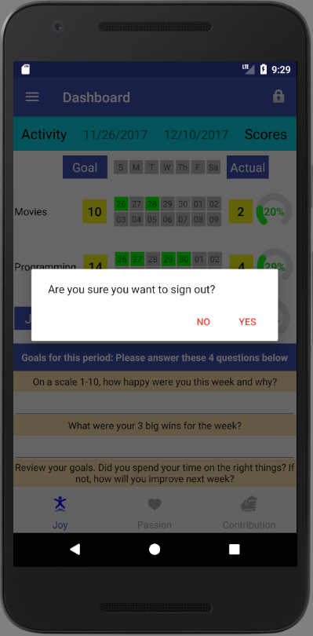
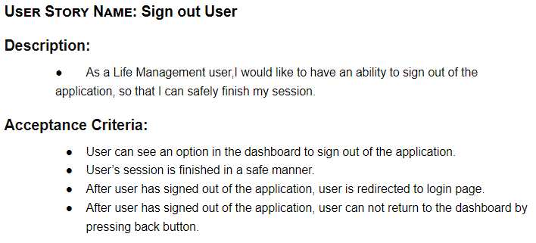
User Story 8 Description

Slide 25
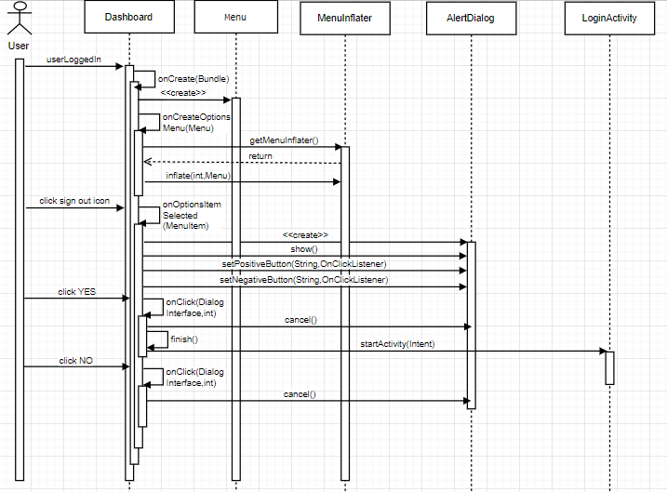
User Story 8 Implementation

Slide 26
Verification
Unit testing was performed for each user stories
Integration testing was performed throughout application development
Usability testing were performed by letting friends use the application and getting their feedback
Product owner validated the system during our bi-weekly meetings where we demo the application

Slide 27
Summary
Life Management Mobile App helps users find happiness and purpose in life in a fun and engaging way
Users can update, visualize and assess their progress to make necessary adjustments in their life
Users can communicate with life coaches for support and guidance
THANK YOU FOR YOUR ATTENTION!

